Slide 1


RISK MANAGEMENT ROADMAP
2021
Maurice Edwards

Slide 2
Roadmap to Success
Risk Management Drivers & Objectives
Approach
Project Timeline
Budget
Reporting

Slide 3
Risk Management Drivers & Objectives
1
Instil a culture where risk management and risk ownership are being practiced as the responsibility of every employee.
2
Create an appropriate awareness and understanding of risks throughout the Group to enable risks to be engaged in an informed manner.
3
Proactively identify and appropriately manage risks within the risk appetite of the Group.
4
5
Embed risk management in the way the Group is managed and the way in which it operates, and
Comply with the appropriate risk management practices as required in terms of corporate governance guidelines.

Slide 4
Approach
Define governance process
Identify business units in scope
Assign regional and division leads
Communicate objectives
Introduce ERM concepts
Facilitate interviews
Identify risks
Assess Impact and Likelihood
Provide summary view of CRB’s Risk Profile
Highlight major issues
Report results to board
1
2
3
4
5
6
Risk Management
Survey
Describe
Business
Objectives
Identify &
Assess Risks
Evaluate &
Assess
Controls
Report
Findings
Develop
Mitigation
Plans
Enhance Entity Value
Defined Framework
Context
Risk Factors
Residual Risks
Ranking
Action Plan
Internal Risk Assessment Study
Define objectives for each
area: Strategic, Operational,
Financial, Compliance,
Reputation
2) Capture value streams
1) Weight risks
2) Identify key controls and
supporting monitoring reports
3) Assess effectiveness of
controls
4) Identify risk and control owners
1) Create Action Plan
2) Focus: Transfer,
Retain, Avoid, Exploit
3) Integrate into ERM
Program

Slide 5
Project Timeline
Tasks | 2/12 | 2/19 | 2/26 | 3/5 | 3/12 | 3/19 | 3/26 | 4/2 | 4/9 | 4/16 | 4/23 | 4/30 | 5/7 | 5/14 | June
Planning (PMO)
i. ERM Survey
II. Internal Risk Assesssment
1) Human Resources
2) IT
3) EHS
4) Project Operations
5) Business Continuity
6) Financial
7) Compliance & Reputation
8) Strategic & Financial
9) Economic
10) Technological
11) Social & Cultural
12) Political / Soverign
13) Environmental
14) Legal
III. Report Out
Start
2/8 – 2/12
HIGH
2/15– 2/19
2/22/21 – 3/24/23
2/22 – 2/24
2/25 – 3/2
3/3 – 3/5
3/8 – 3/12
Operational Risks
3/15 – 3/16
3/17 – 3/19
Information for
Decision-making
Risks
3/22 – 3/24
3/29 – 3/31
4/1 – 4/2
4/5 – 4/7
4/8 – 4/9
External Risks
4/12 - 4/14
4/15 – 4/16
4/19 – 4/21
Report out
5/14
4/26 – 5/7
BOD 5/24/21
Current

Slide 6
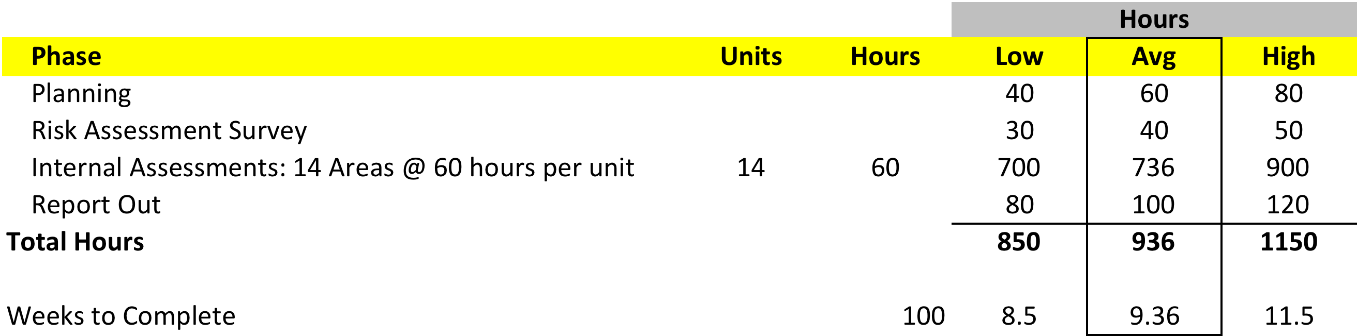
Budget
Key Assumptions:
Three major Phases: Risk Survey, Internal Assessment, and Report Out
14 major focus areas (e.g. IT, Operations, HR, Legal, etc,)
Each focus area has a planning, fieldwork, and wrap-up component
Total hours include 2 consultants from EPIC FT and numerous SME from C&E

Slide 7
Risk Results
Risk Matrix
Legend
Human Resources
Employee/3rd Party Fraud
Relevance
Product Pricing
Customer Satisfaction
Channel Effectiveness
Product Development
Budget and Planning
Cash Flow
Reputation
Technology Infrastructure
Efficiency
Partnering
Measurement
Business Cycle Time
Authority/Limit
Sourcing
Capacity
Alignment
Contract Commitment
Currency
Health and Safety
Business Portfolio
Resource Allocation
HIGH
5
3
8
6
23
4
20
22
10
17
Impact
18
9
14
7
11
24
19
13
12
2
16
15
1
21
LOW
LOW
HIGH
Likelihood of Control Issues

Slide 8
Reporting
Our reports are designed to allow users to understand the importance of issues raised. Succinct Executive Summaries and Action Matrices that highlight important issues are a key part of our reporting style. The reports will have a format very similar to this document and can be tailored to meet your specific needs. Reports issued typically include the following key sections:
Executive Summary
A high-level overview of the engagement, including scope of the work, audit objectives, and the actual work performed.
Benchmark
Diagnostics
Quantitative diagnostic questionnaire results that have been benchmarked against Industry Best Practices database.
Information on the process being reviewed, including process background, statistics, graphs.
Discussion of key issues identified during the engagement, including recommendations that have been agreed upon by management with committed implementation timeframes.
Background
Action
Matrix
Best Practices/
Internal Control Scorecard
An evaluation of the company’s practices and internal controls against Best Practices/Internal Controls.
Process
Flowcharts
Graphical representation of the process being reviewed which identifies key internal control points, Best Practices and internal control/process improvement opportunities.

Slide 9
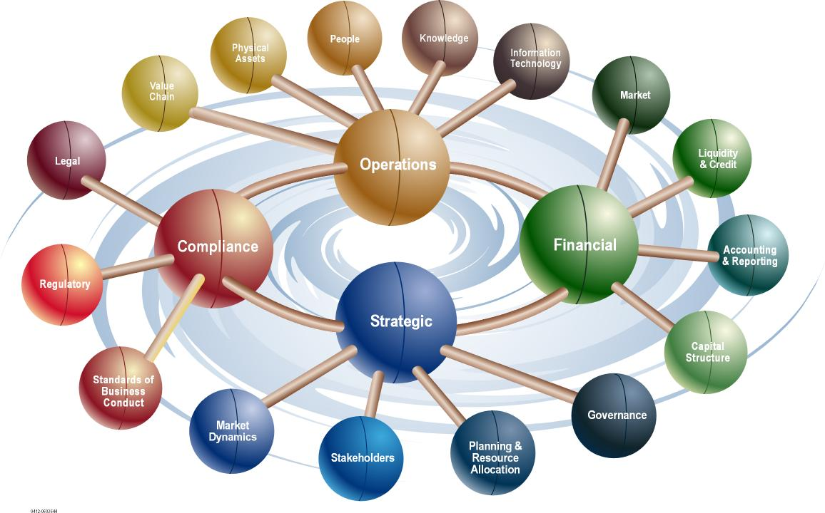
Risk Universe – Risk Identification

Slide 10
Risk Universe – Risk Identification
The Model:
Use the Business Risk Model as a framework for:
Defining an organization’s business risk universe.
Identifying key business risks impacting the organization as a whole or one or more business processes.

Slide 11

Thank You

